Slide 1
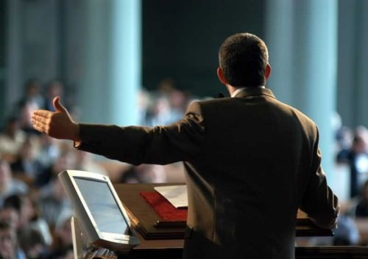
Chapter 18
Persuasive Speaking

Slide 2
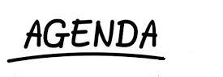
Persuasive Speaking
Pillars of Persuasion
Building Credibility
Persuasive Speaking
Digital Media and Persuasion

Slide 3
Persuasion
“Remember that what pulls the strings is the force hidden within; there lies the power to persuade”
Marcus Aurelius
“The truth isn't the truth until people believe you”
- William Bernbach
Blend Images/Getty Images

Slide 4
Persuasion
The process of motivating a person through communication and relationship building to change an attitude, belief, value, or behaviour.
Blend Images/Getty Images

Slide 5

Persuasive Speeches
Persuasive speeches aim to change others by prompting them to think, feel, believe, or act differently
Blend Images/Getty Images

Slide 6
Qualities of a Persuasive Speech
Speaker and listeners interact
It is not coercive
Effects are usually incremental or gradual

Slide 7
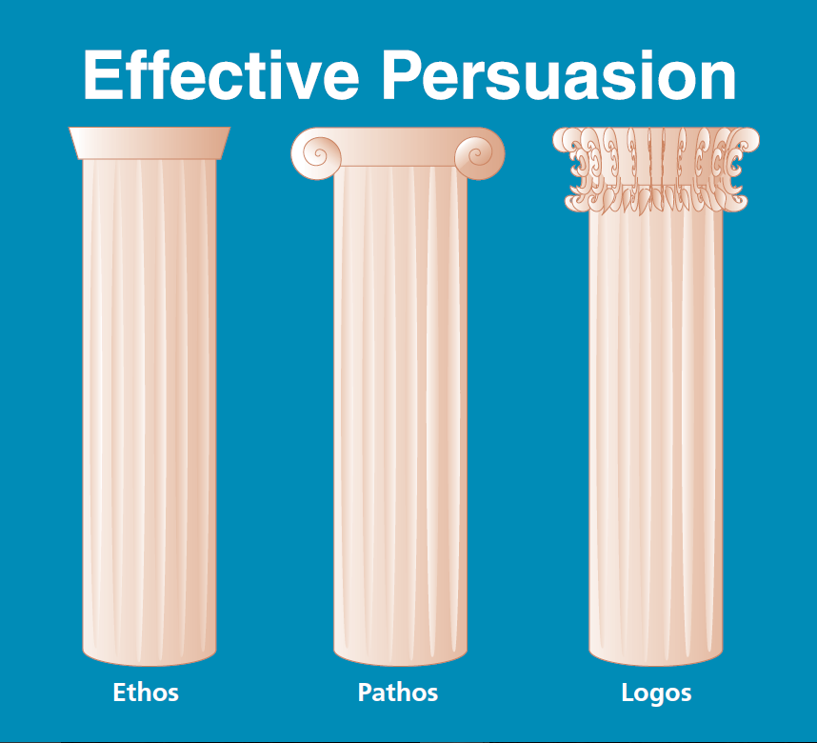
Pillars of Persuasion
Ethos
Pathos
Logos
Cengage Learning

Slide 8

Ethos
Perceived personal character of the speaker
wavebreakmedia/Shutterstock.com

Slide 9
Ethos (cont’d)
Cengage Learning

Slide 10
Pathos
Emotional reasons for attitudes, beliefs, or actions
Hero Images/Getty Images

Slide 11
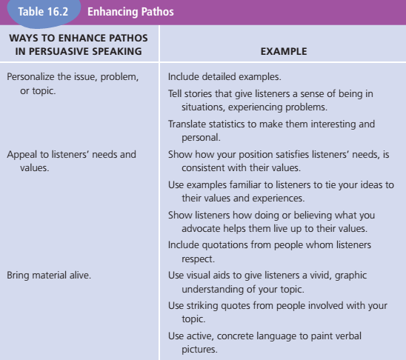
Pathos (cont’d)
Cengage Learning

Slide 12
Logos
Rational or logical proof
Forms of reasoning
Inductive
Uses specific examples to draw a general conclusion
Deductive
Begins with general claim
Proceeds with specific claim
Ends with conclusion

Slide 13
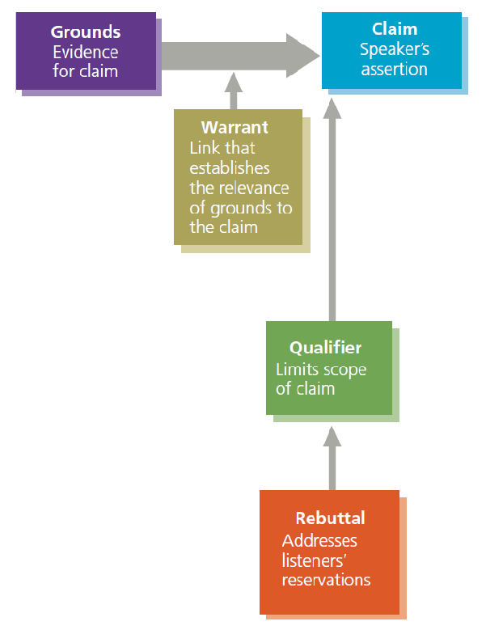
Toulmin Model
Main components
Claim
Grounds
Warrant
Also includes
Qualifier
Rebuttal
Cengage Learning

Slide 14
Building Credibility
Credibility: the perception that a person (speaker) is informed and trustworthy
Can be earned by convincing listeners a speaker has integrity and goodwill toward them and can be trusted

Slide 15
Types of Credibility (Ethos)
Initial
Expertise, trustworthiness recognized before a presentation begins
Derived
Credibility gained during the presentation
Terminal
Credibility at the end of the presentation

Slide 16
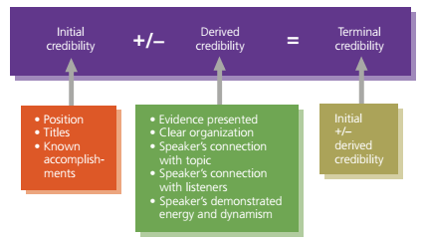
Developing Credibility
Cengage Learning

Slide 17
Enhancing Credibility
State your qualifications
Show listeners you care about them
Appeal to listener’s emotions
Use effective, ethical supporting material
Communicate verbally and nonverbally your connection to the topic

Slide 18
Motivated Sequence Pattern
Attention
Need
Satisfaction
Visualization
Call to action

Slide 19
One-Sided and Two-Sided Presentations
When making this decision, take into consideration :
Listeners’ expectations
Listeners’ attitudes
Listeners’ knowledge
Inoculation

Slide 20
Effective Persuasive Speeches
Create common ground with listeners
Adapt to listeners
Avoid fallacious reasoning
false or flawed logic
Intentional or unintentional

Slide 21
Ad Hominem Arguments
Go to the person instead of the idea
“You can’t believe what Jane Smith says about voting because she doesn’t vote.”
“We shouldn’t stay here and listen to an ex-con and a confessed criminal tell us how to restore values to our teens.”

Slide 22
Post Hoc, Ergo Propter Hoc
“After this, therefore because of this”
Argue that a coincidental sequence is causal
“The new flextime policy is ineffective because more people have been late getting to work since it went into effect.”

Slide 23
Bandwagon Appeal
Argues that because many people believe or act in a particular way, you should too
“Carpooling to cut down on the campus parking problem is a stupid idea. Look around – nobody carpools.”
“You need to try using Brand X; 10,000 satisfied customers can’t be wrong.”

Slide 24
Slippery Slope
Once we take the first step, more and more steps inevitably will follow
“Restricting logging is only the first step. Next, the environmentalists will want to prohibit any timber cutting. Pretty soon, we won’t be able to build homes or furniture.”

Slide 25
Hasty Generalization
A broad claim based on insufficient evidence
“Three congressional representatives have had affairs. Therefore, all members of Congress are unethical.”
“Brand X worked for me! Therefore, everyone should buy Brand X.”

Slide 26
Red Herring
Arguments that attempt to deflect listeners from relevant issues
Victor confronted his boss about recent wage cutbacks. His boss responded, “Well, you could be making $35 a week as I did when I was your age.”

Slide 27
Either-Or Logic
An argument that wrongly suggests only two options are available
“Either abolish fraternities on our campus or accept the fact that this is a party school where drinking is more important than learning.”
“America, love it or leave it.”

Slide 28
Halo Effect
Occurs when we generalize a person's authority or expertise in a particular area to other areas that are irrelevant to the person’s experience and knowledge
“World-famous athlete Michael Jordan urges us to buy a particular brand of underwear.”

Slide 29
Summary
Persuasion Definition
Characteristics of Good Persuaders
Three Pillars
Chapter 18
Fallacies
Toulmin Model
Persuasive Speeches
Credibility

